Slide 1
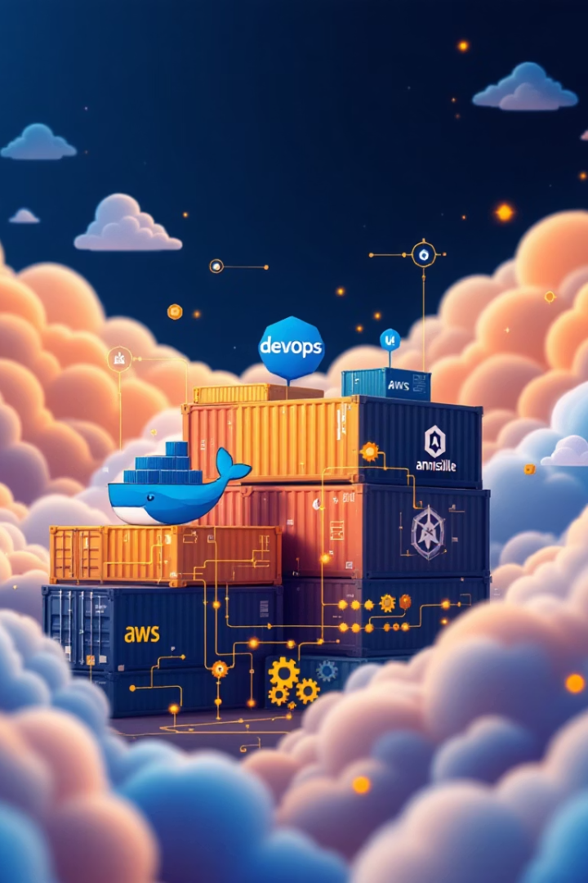
Simplifying and Dockerizing an NLP Application with DevOps tools
DEPI DevOps Graduation Project
by ahmed hosny
ah

Slide 2





Application Overview
Web Application
Flask app with login , signup and home pages
Data Storage
PostgreSQL for user management
URL Processing
Input for article sentiment analysis
AI Integration
Calls Hugging Face API for processing

Slide 3
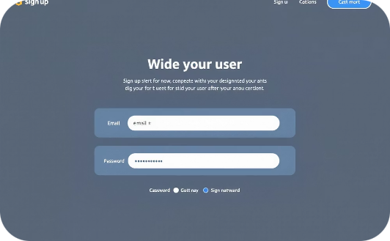

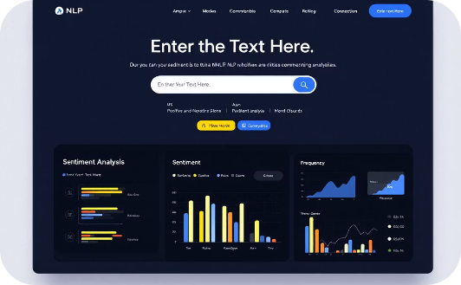
APP Flow and Demo
Sign Up
Login
Home Page
New users create accounts with email and password. Credentials are securely stored in PostgreSQL database.
Returning users authenticate through secure login. Session management ensures protected access to app features.
Users paste article URLs for instant sentiment analysis. Hugging Face API processes text and returns comprehensive results.

Slide 4
Application Architecture
Flask Container
PostgreSQL Container
Hosts web application
Stores user data
Manages login/signup
Manages credentials
Handles URL submission
Ensures data persistence
Processes sentiment analysis

Slide 5
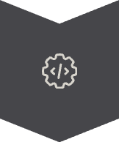


Enhancing Deployment with CI/CD and Containerization
Implement CI/CD
Automate building , testing and deployment
Use Containerization
Ensure consistency
Improve Deployment
Enhance scalability

Slide 6
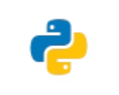

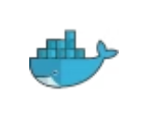



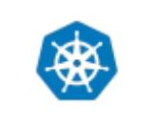


Tools and Technologies
Powerful tools integrated for seamless development, testing, and deployment

Slide 7





CI/CD Pipeline Overview
Environment Setup
Configure variables and credentials
Build & Dockerize
Create Flask app container
Run Tests
Pytest in Docker Compose
Push Image
Upload to Docker Hub
Deploy
Local and AWS deployment

Slide 8
CI/CD Pipeline: Stage Details
Set Environment Variables
Store API keys and credentials
Build Stage
Containerize Flask app with Dockerfile
Test Stage
Run containers with pytest
Push Stage
Push image to Docker Hub
Local Deployment
Ansible and Kubernetes
AWS Infrastructure
CloudFormation setup
Remote Deployment
Ansible on EC2

Slide 9
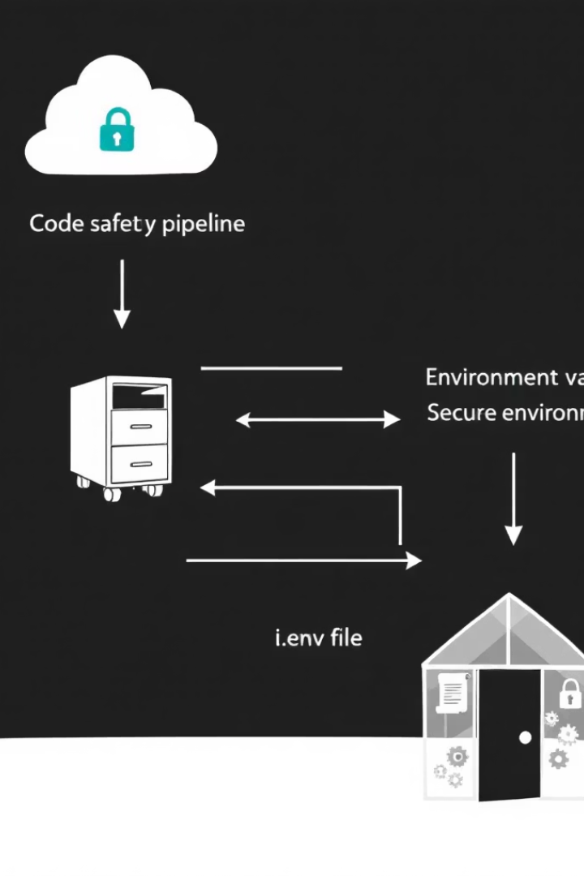
Stage 1: Prepare Environment
Load secure environment variables required for the application.
Use Jenkins credentials to access the .env file containing API keys, database credentials, and deployment secrets.
Copy the .env file into the project directory to be used in subsequent stages.
This stage ensures all sensitive configuration is managed securely and is available for building, testing, and deployment.

Slide 10
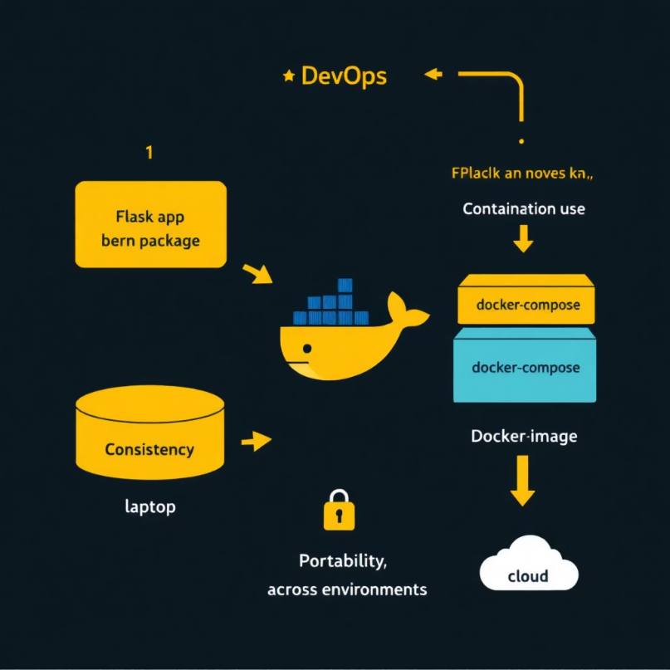
Stage 2: Build Docker Image
Build the Flask web application into a Docker image using docker-compose.
The image includes all application dependencies defined in the Dockerfile.
This stage guarantees that the application runs consistently across different environments by packaging it into a container.
Containerizing the app ensures portability, reliability, and ease of deployment.

Slide 11
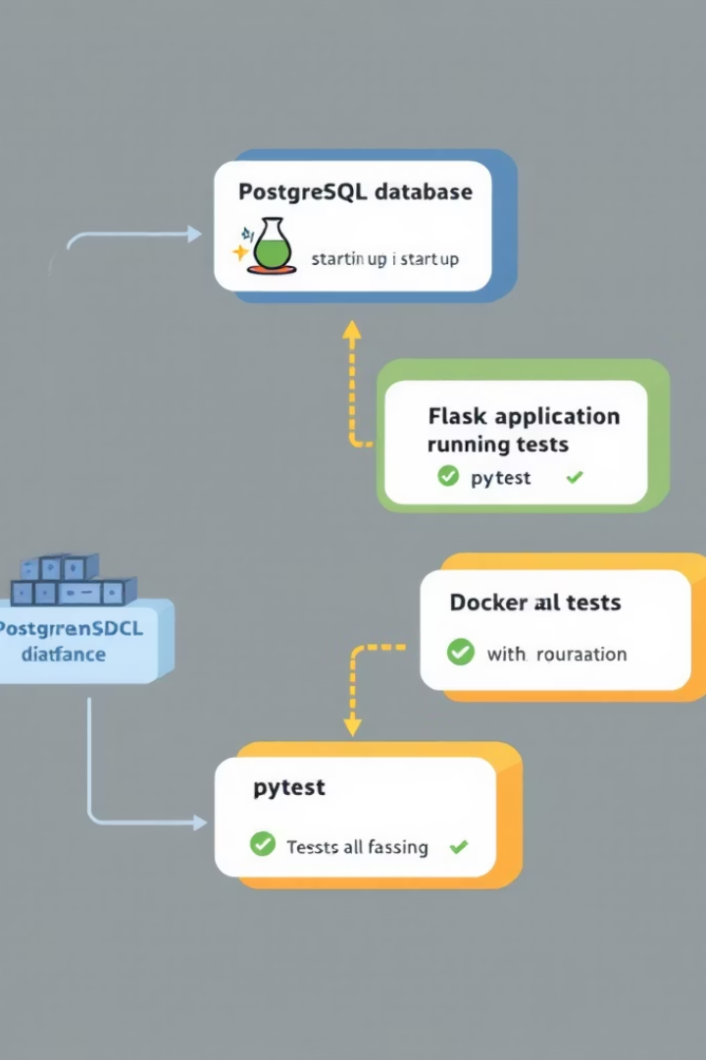
Stage 3: Run Automated Tests
Start the PostgreSQL container using Docker Compose.
Run the Flask app container with overridden command to execute pytest.
Execute unit tests to validate the application functionality before deployment.
Automatically shut down containers after testing.
This stage ensures code reliability and catches issues early in the CI/CD pipeline.

Slide 12
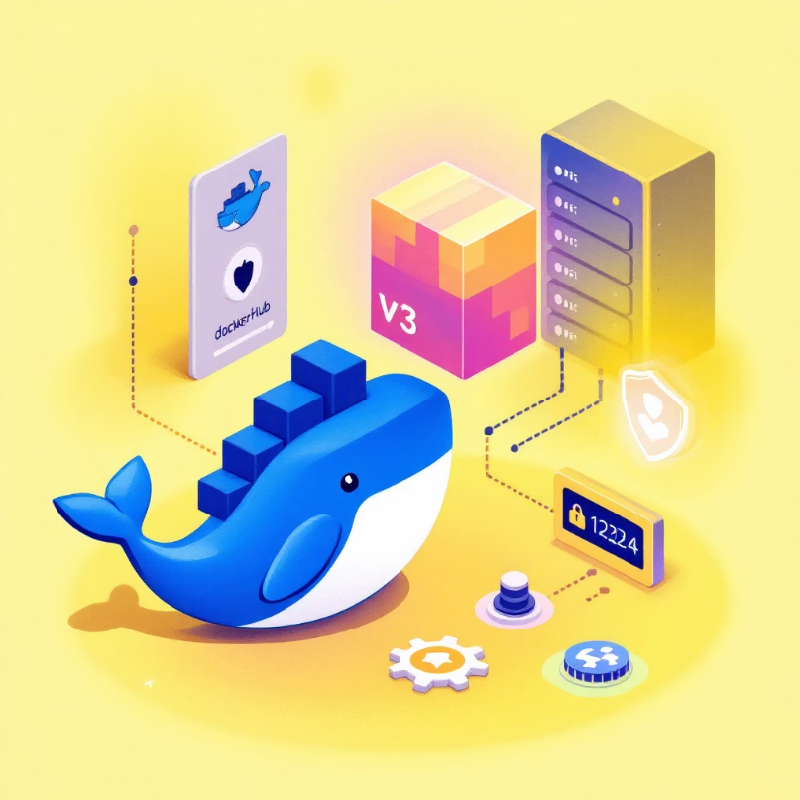
Stage 4: Push Docker Image to Docker Hub
Log in securely to Docker Hub using Jenkins credentials.
Use the Jenkins build number to tag the Docker image uniquely (e.g., v1, v2, ...).
Push the versioned image to a remote Docker Hub repository.
This stage ensures that each deployment uses a properly versioned and traceable container image.

Slide 13
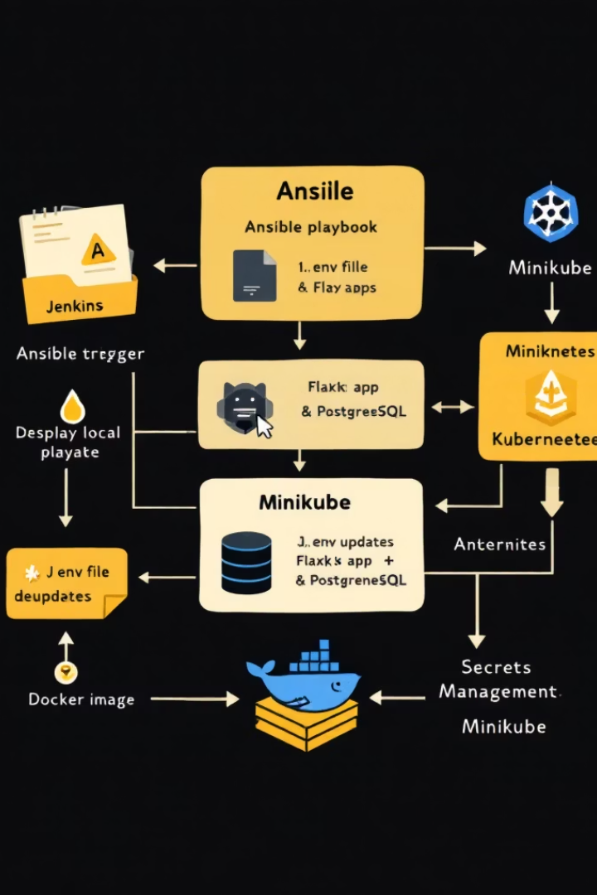
Stage 5: Local Deployment with Ansible & Kubernetes
Update the .env file with build version and Docker credentials.
Use Ansible to automate local deployment via Kubernetes on Minikube.
Tasks include:
Generating deployment files with envsubst.
Creating Kubernetes secrets from environment variables.
Applying deployments for PostgreSQL and the Flask app.
This stage mimics production using local infrastructure, ideal for validation before cloud deployment.

Slide 14
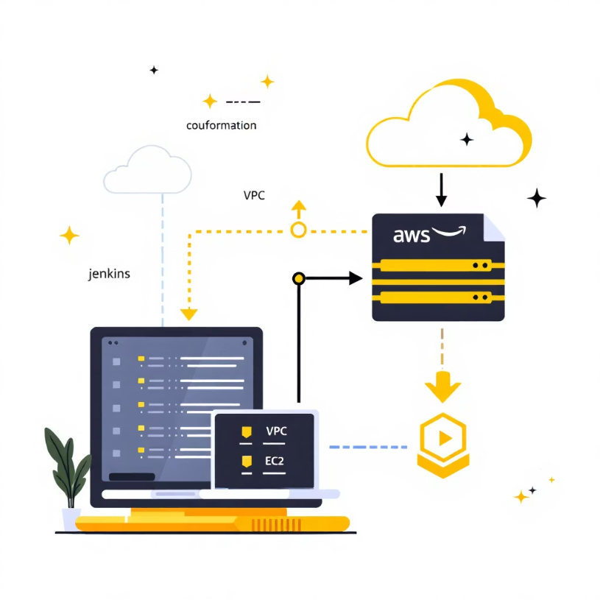
Stage 6: Build AWS Infrastructure
Deploy AWS infrastructure using CloudFormation through the Jenkins pipeline.
Use AWS CLI to create and update CloudFormation stacks for network and server resources.
Provision critical components such as VPC, public network, Internet Gateway, EC2 instances, and security groups.
Tag resources for project identification and reference outputs for later deployment steps.
This stage sets up the scalable and secure cloud environment needed for remote deployment.

Slide 15

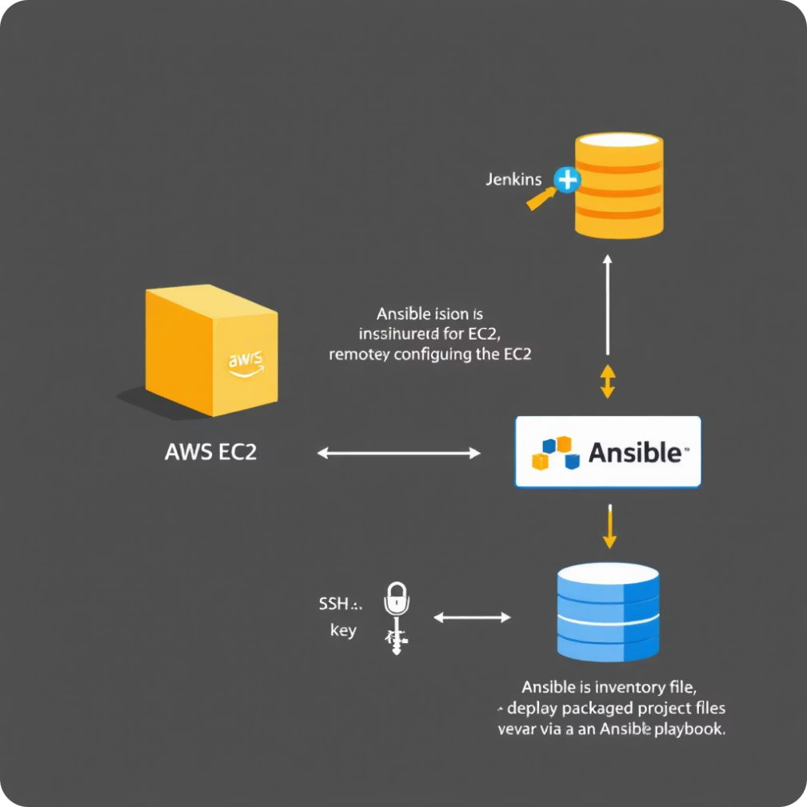
Stage 7: Configure EC2 & Remote Deployment
Retrieve Instance IP:
Use AWS CLI to get the public IP of the target EC2 instance.
Generate an Ansible inventory file with the retrieved IP.
Prepare Deployment Package:
Update the .env file with necessary parameters.
Archive the project files (including app code, configurations, and dependencies).
Deploy via Ansible:
Execute an Ansible playbook to copy the project to the EC2 instance.
Untar the package, tear down any existing services, and recreate containers using Docker Compose.
Verify that both the Flask app and PostgreSQL services are running properly.

Slide 16
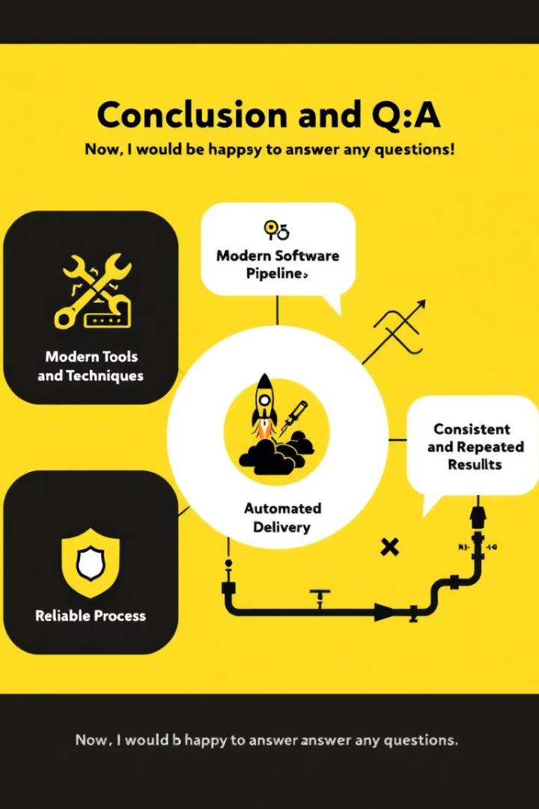
Conclusion and Q&A
1
2
Simplified Deployment
Faster Delivery
Modern tools and techniques
Automated software pipeline
3
Reliable Process
Consistent and repeatable
Now, I would be happy to answer any questions.

